Slide 1

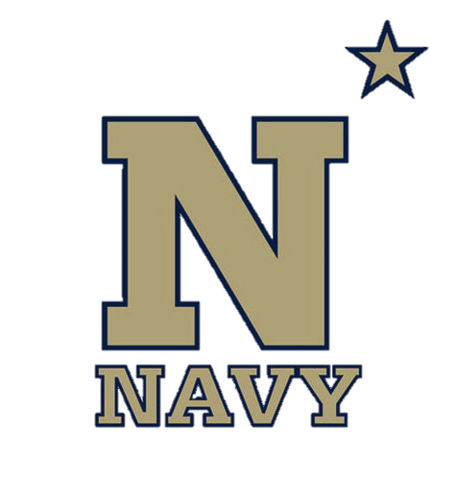
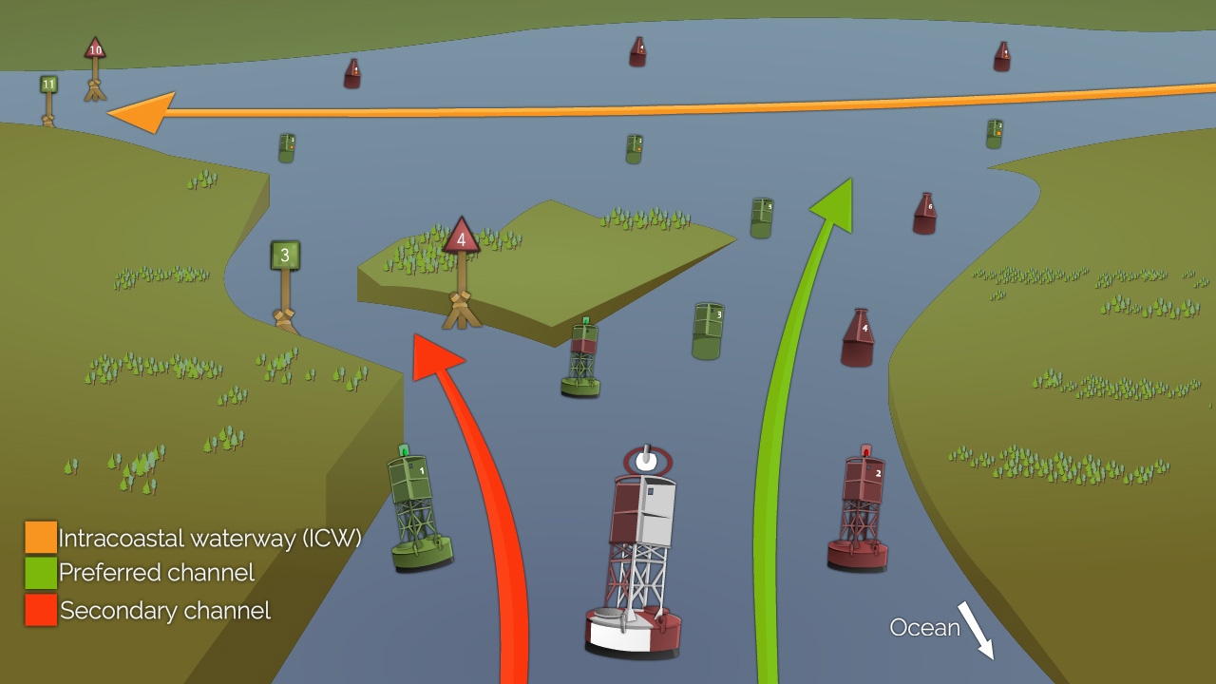
Short Range Aids to Navigation
NN220-04
SEANAV I United States Naval Academy
NN220 – Fundamentals of Navigation– Updated May 2023
Operations Officer I HMS PROTECTOR A173 I The Ice Patrol Ship

Slide 2
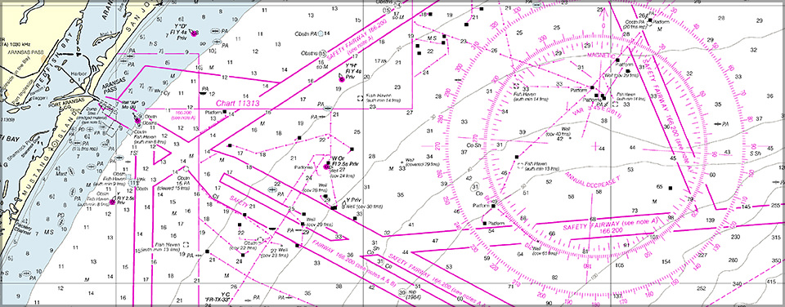
References
-The American Practical Navigator, Pub. No. 9, Bowditch, VOL. 1, 2019 Edition -Surface Ship Navigation Department Organizations and Regulations Manual (NAVDORM), COMNAVSURFPAC/COMNAVAIRPAC/COMNAVAIRLANT/COMNAVSURFLANT INSTRUCTION 3530.4 series
SEANAV I United States Naval Academy
NN220 – Fundamentals of Navigation
Operations Officer I HMS PROTECTOR A173 I The Ice Patrol Ship

Slide 3
Enabling Objectives
1 - UNDERSTAND the terms ATON, RACON and AIS-TON. 2 - UNDERSTAND the lateral and cardinal maritime buoyage system. 3 - DESCRIBE the International Association of Marine Aids to Navigation and Lighthouse Authorities (IALA). 4 - IDENTIFY the difference between IALA Region A and IALA Region B and know what we use in the U.S. 5 - DEFINE the term Buoy, and know the difference between Lighted, Unlighted, Special Purpose and Preferred Channel Buoys. 6 - IDENTIFY the five different buoy shapes. 7 - DESCRIBE buoy maintenance and know who is responsible for the maintenance of buoys. 8 - UNDERSTAND buoy limitations and their impact on navigation. 9 - DESCRIBE Cardinal Marks and their use. 10 - DESCRIBE Isolated Danger Marks and their use. 11 - DESCRIBE Safe Water Marks and their use. 12 - DEFINE the term Beacon, and know the difference between Major and Minor Lights, Unlighted Beacons and Sector Lights. 13 - DESCRIBE Range Lights and their application in transiting a range line. 14 - DEFINE period, fixed, flashing, occulting and isophase as they relate to light characteristics. 15 - DESCRIBE a light’s characteristics given its charted description. 16 - IDENTIFY the types of sound signals used on aids to navigation and know their limitations. 17 - UNDERSTAND U.S. Aids to Navigation System (USATONS) and its objectives with regards to navigation.
SEANAV I United States Naval Academy
NN220 – Fundamentals of Navigation
Operations Officer I HMS PROTECTOR A173 I The Ice Patrol Ship

Slide 4
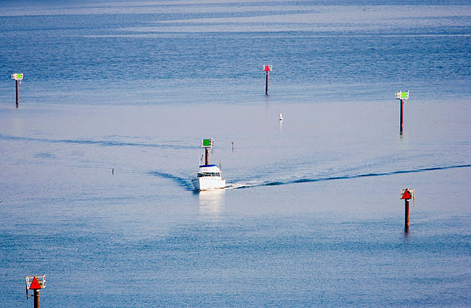
Short Range Aids to Navigation
-Short Range/Visual Aids to Navigation (ATON) are a series of interacting external devices intended to provide information to the navigator about: Where to safely navigate within a channel The general position of their ship in regard to the channel The traffic lanes in and out of a port or congested waterway.
SEANAV I United States Naval Academy
NN220 – Fundamentals of Navigation
Operations Officer I HMS PROTECTOR A173 I The Ice Patrol Ship

Slide 5
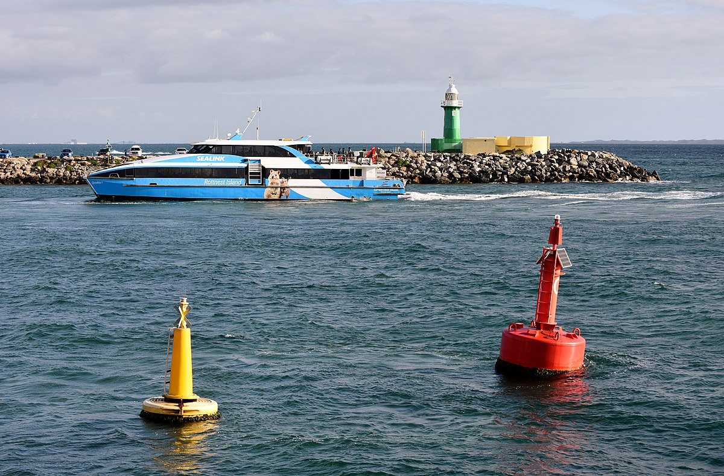
Short Range Aids to Navigation
-Short range aids to navigations (ATON) are a series of interacting external devices intended to provide information to the navigator about: Where to safely navigate within a channel
SEANAV I United States Naval Academy
NN220 – Fundamentals of Navigation
Operations Officer I HMS PROTECTOR A173 I The Ice Patrol Ship

Slide 6
Short Range Aids to Navigation
-Short Range/Visual Aids to Navigation (ATON) includes all navigational devices within visual, audio or RADAR range of the mariner, specifically: Buoys (Lighted, Unlighted, and Special Purpose) Beacons (Lighthouses, Lights, Ranges, Leading Lights, and Daybeacons) Sound Signals RADAR beacons (RACON)-Beacons that display a specific pattern on the RADAR display when pinged. Automatic Identification System – Aids to Navigation (AIS-TON)-Will display AIS information on a shipboard AIS receiver.
SEANAV I United States Naval Academy
NN220 – Fundamentals of Navigation
Operations Officer I HMS PROTECTOR A173 I The Ice Patrol Ship

Slide 7
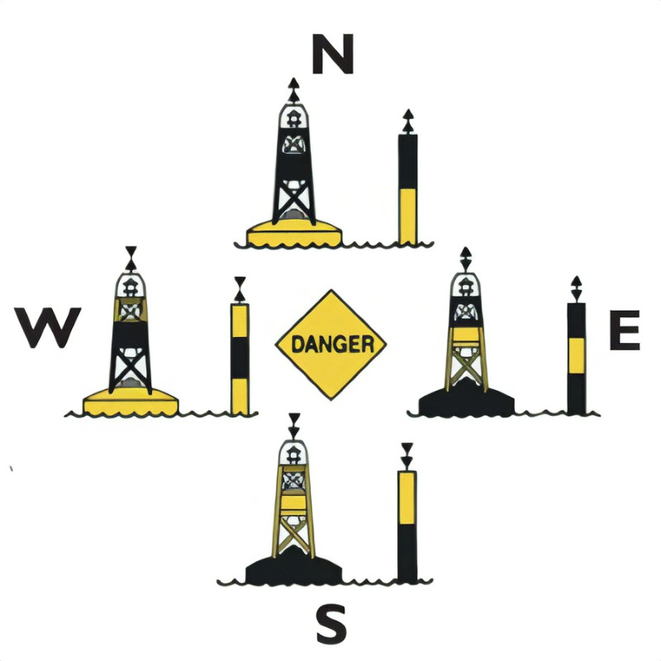
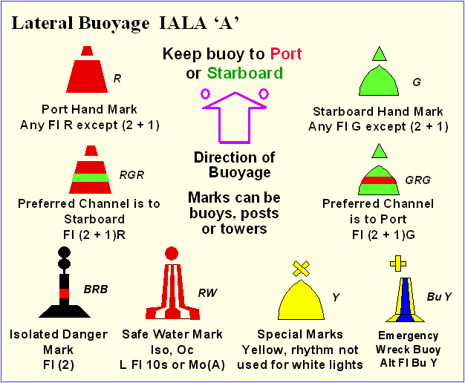
Lateral System vs. Cardinal System
-There are two major types of buoyage systems used in the world today: Lateral System Cardinal System
SEANAV I United States Naval Academy
NN220 – Fundamentals of Navigation
Operations Officer I HMS PROTECTOR A173 I The Ice Patrol Ship

Slide 8
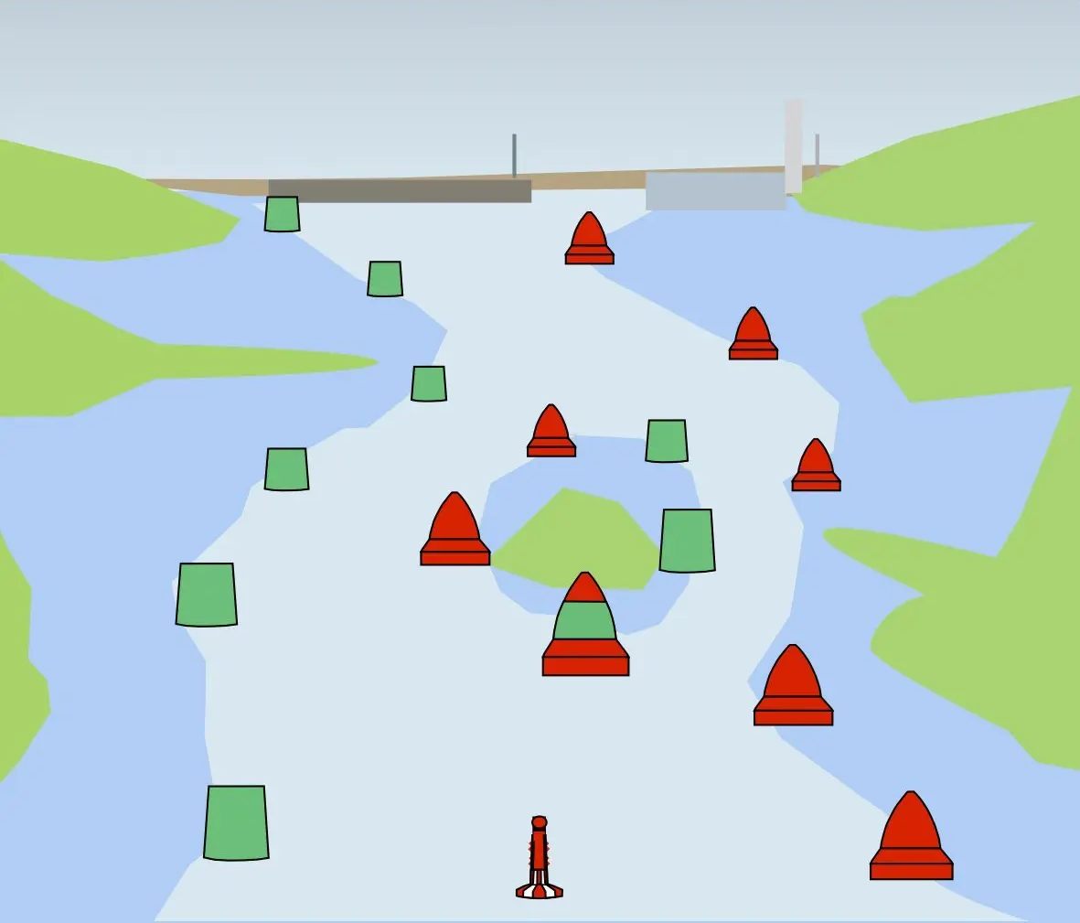
Lateral System
-The Lateral System is best suited for well-defined channels. It can be described as: The description of each buoy indicates the direction of danger relative to the course which is normally followed. The position of the marks are determined by the general directions taken by the mariner when approaching port from seaward. The vast majority of channels going into ports are defined as a lateral system.
SEANAV I United States Naval Academy
NN220 – Fundamentals of Navigation
Operations Officer I HMS PROTECTOR A173 I The Ice Patrol Ship

Slide 9
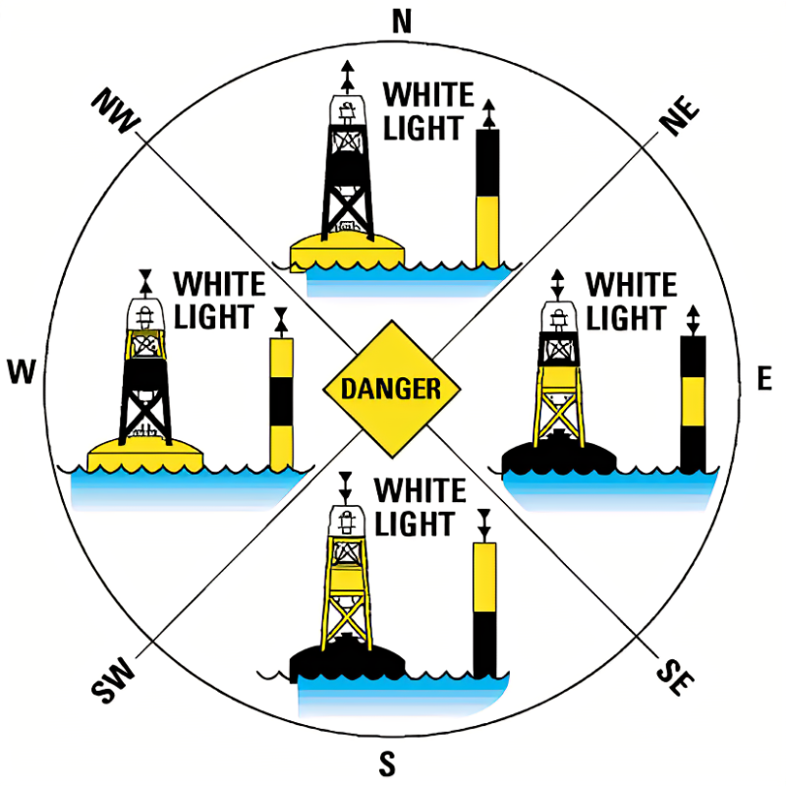
Cardinal System
-The Cardinal System is best suited for coasts with numerous isolated rocks, shoals and islands. It can be described as: The characteristic of each buoy indicates the approximate true bearing of the danger it marks. Thus, an eastern quadrant buoy marks a danger which lies to the west of the buoy.
SEANAV I United States Naval Academy
NN220 – Fundamentals of Navigation
Operations Officer I HMS PROTECTOR A173 I The Ice Patrol Ship

Slide 10
IALA Maritime Buoyage System
-There was a long standing disagreement on how to properly mark channels. -Most countries adopted the lateral system and a few adopted the cardinal system. -In 1957, the International Association of Marine Aids to Navigation and Lighthouse Authorities (IALA) was formed to create unity between the two systems. -IALA formed a buoyage system to include BOTH lateral and cardinal marks. -Today we have two IALA Maritime Buoyage Systems: Region A Region B
SEANAV I United States Naval Academy
NN220 – Fundamentals of Navigation
Operations Officer I HMS PROTECTOR A173 I The Ice Patrol Ship

Slide 11
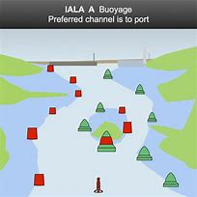
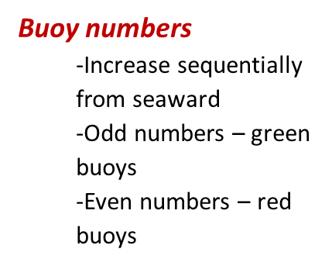
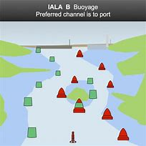
IALA A vs. IALA B
-IALA Region A is identified by green buoys to starboard when entering from sea. Europe, Africa, Australia and most of Asia use IALA A. “Red Right Leaving” -IALA Region B is identified by red buoys to starboard when entering from sea. North, Central, South America, Japan, Korea and Philippines use IALA B. “Red Right Returning”
SEANAV I United States Naval Academy
NN220 – Fundamentals of Navigation
Operations Officer I HMS PROTECTOR A173 I The Ice Patrol Ship

Slide 12
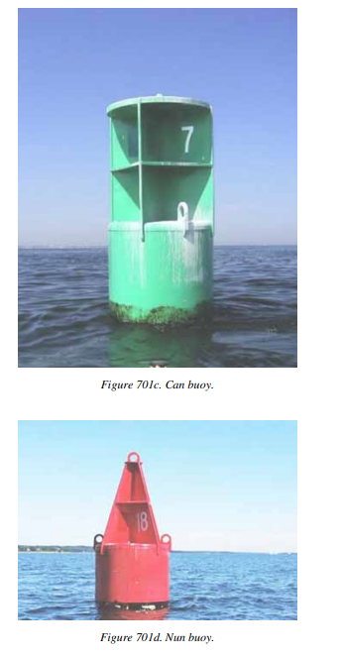
Buoys
-Buoys are floating aids to navigation, anchored at specific locations. -They can be equipped with lights and sound signal devices (Bell, Whistle, Gong, Electronic Horn). -They are used to mark channel limits, indicated isolated dangers, shoals, obstructions, and to warn the mariner. -Buoys come in 5 basic shapes: Can Cone (Nun buoy falls into this) Sphere Pillar Spar
SEANAV I United States Naval Academy
NN220 – Fundamentals of Navigation
Operations Officer I HMS PROTECTOR A173 I The Ice Patrol Ship

Slide 13
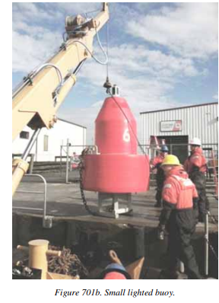
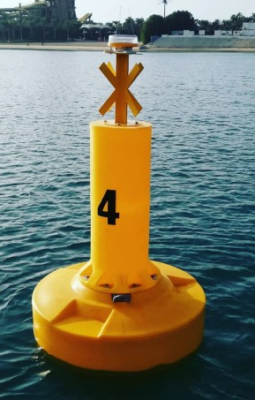
Lighted, Unlighted and Special Purpose Buoys
-Lighted Buoys are configured with an LED lantern and have three components:
Hull
Counterweight
Superstructure
-Unlighted Buoys are classified by their shape:
Can
Nun
Special Purpose
-Special Purpose Buoys are typically owned
by government Agencies. They are used as
Navigational marks and data collection.
SEANAV I United States Naval Academy
NN220 – Fundamentals of Navigation
Operations Officer I HMS PROTECTOR A173 I The Ice Patrol Ship

Slide 14
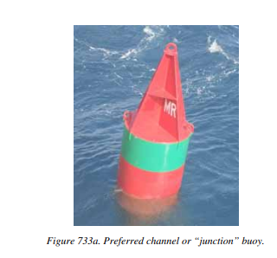
Preferred Channel Buoy
-A Preferred Channel Buoy is a red and green horizontally banded buoy or beacon that mark junctions or bifurcations in a channel or obstructions which may be passed on either side. -The topmost color will correspond with the preferred channel. -If the topmost color is red, you should treat it As a red buoy and keep it to starboard as you are returning to port. -If the topmost color is green, you should treat it as a green buoy and keep it to port as you are returning to port.
SEANAV I United States Naval Academy
NN220 – Fundamentals of Navigation
Operations Officer I HMS PROTECTOR A173 I The Ice Patrol Ship

Slide 15
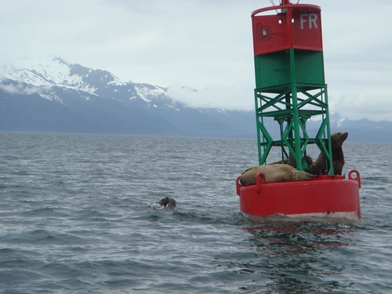
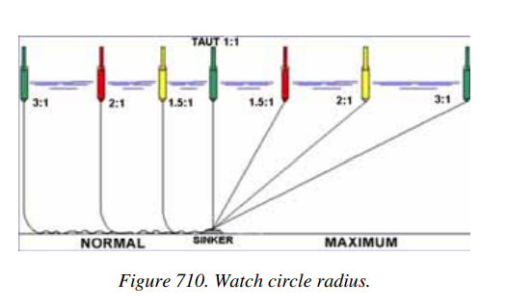
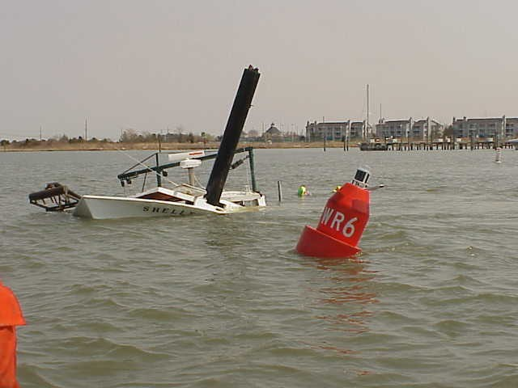
Buoy Limitations
-Buoys cannot be relied on to maintain precise position. -Buoys are subject to hazards such as weather, equipment failure and mooring casualties. -Buoy allisions are also common, even in good weather. YPs are guilty of this!!! -Buoys should never be used for precise navigation. -Vessels should report any discrepancies to the nearest Coast Guard District.
SEANAV I United States Naval Academy
NN220 – Fundamentals of Navigation
Operations Officer I HMS PROTECTOR A173 I The Ice Patrol Ship

Slide 16
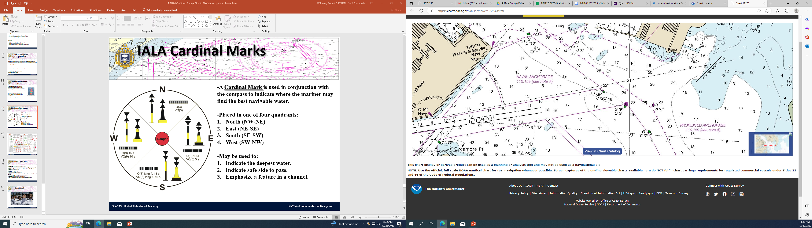
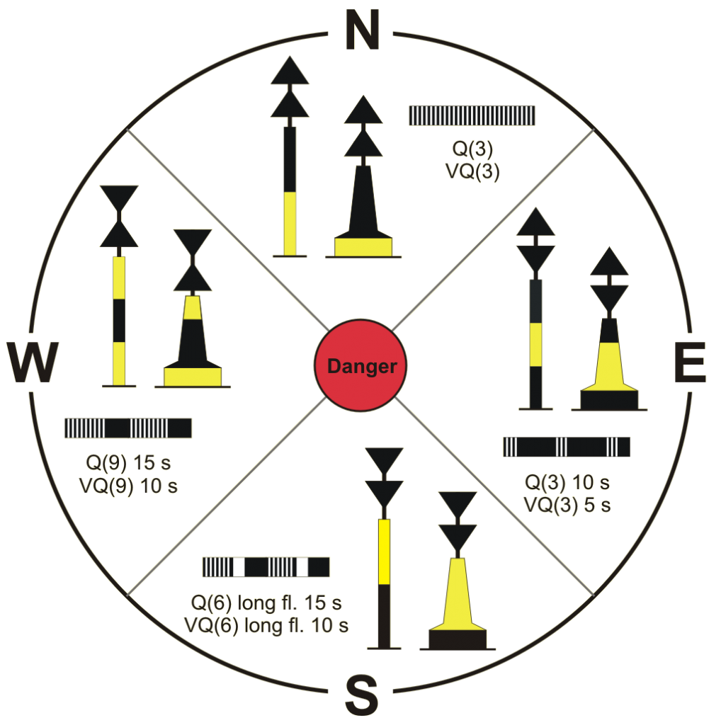
IALA Cardinal Marks
-A Cardinal Mark is used in conjunction with the compass to indicate where the mariner may find the best navigable water.
-Placed in one of four quadrants:
North (NW-NE)
East (NE-SE)
South (SE-SW)
West (SW-NW)
-May be used to:
Indicate the deepest water.
Indicate safe side to pass.
Emphasize a feature in a channel.
Spa Creek Preferred Channel Buoy
SEANAV I United States Naval Academy
NN220 – Fundamentals of Navigation
Operations Officer I HMS PROTECTOR A173 I The Ice Patrol Ship

Slide 17
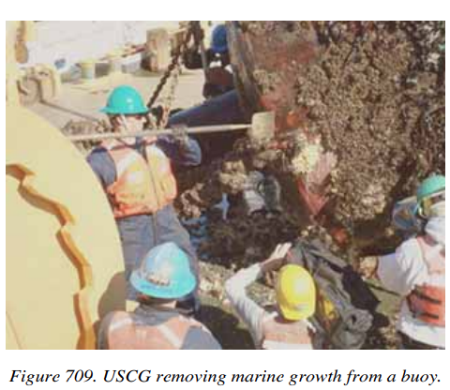
Buoy Maintenance
-Buoy maintenance is the scheduled or on-scene maintenance of buoys consisting of inspecting and replacing the buoy numbers, reflective tape, light, power, sound and buoy mooring equipment. -Actions may also include cleaning, inspecting and repairing the buoy hull, superstructure and counterweight. -Also to verify that the buoy is within tolerance of assigned position. -The US Coast Guard is predominately responsible for the maintenance of U.S. Aids to Navigation (USATONS).
SEANAV I United States Naval Academy
NN220 – Fundamentals of Navigation
Operations Officer I HMS PROTECTOR A173 I The Ice Patrol Ship

Slide 18
Buoy Limitations
-Buoys cannot be relied on to maintain precise position. -Buoys are subject to hazards such as weather, equipment failure and mooring casualties. -Buoy allisions are also common, even in good weather. YPs are guilty of this!!! -Buoys should never be used for precise navigation. -Vessels should report any discrepancies to the nearest Coast Guard District.
SEANAV I United States Naval Academy
NN220 – Fundamentals of Navigation
Operations Officer I HMS PROTECTOR A173 I The Ice Patrol Ship

Slide 19
Buoy Limitations
-Buoys cannot be relied on to maintain precise position. -Buoys are subject to hazards such as weather, equipment failure and mooring casualties. -Buoy allisions are also common, even in good weather. YPs are guilty of this!!! -Buoys should never be used for precise navigation. -Vessels should report any discrepancies to the nearest Coast Guard District.
SEANAV I United States Naval Academy
NN220 – Fundamentals of Navigation
Operations Officer I HMS PROTECTOR A173 I The Ice Patrol Ship

Slide 20
IALA Cardinal Marks
-A Cardinal Mark is used in conjunction with the compass to indicate where the mariner may find the best navigable water. Typically a pillar or spar buoy.
-Black and yellow in color.
-Exhibits white light based on quick or very quick flashing lights.
-Placed in one of four quadrants:
North (NW-NE) (Two triangles facing up)
East (NE-SE) (Two triangles bases together)
South (SE-SW) (Two triangles facing down)
West (SW-NW) (Two triangles apexes together)
-May be used to:
Indicate the deepest water.
Indicate safe side to pass.
Emphasize a feature in a channel.
SEANAV I United States Naval Academy
NN220 – Fundamentals of Navigation
Operations Officer I HMS PROTECTOR A173 I The Ice Patrol Ship

Slide 21
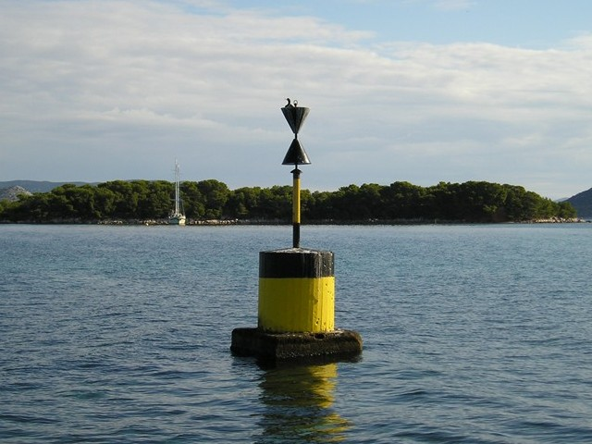
IALA Cardinal Marks
-A Cardinal Mark is used in conjunction with the compass to indicate where the mariner may find the best navigable water.
-Placed in one of four quadrants:
North (NW-NE)
East (NE-SE)
South (SE-SW)
West (SW-NW)
-May be used to:
Indicate the deepest water.
Indicate safe side to pass.
Emphasize a feature in a channel.
SEANAV I United States Naval Academy
NN220 – Fundamentals of Navigation
Operations Officer I HMS PROTECTOR A173 I The Ice Patrol Ship

Slide 22
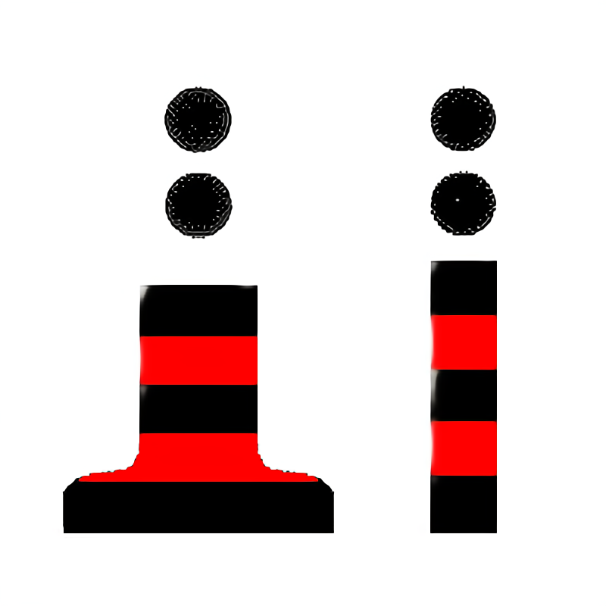
IALA Isolated Danger Marks
-An Isolated Danger Mark is erected on, or moored on or above, an isolated danger which has navigable water around it. Typically a pillar or spar buoy. -On a chart, the position of the danger is the center of the symbol. In reality, there may be a slight offset, so give it space! -Black with one or more red horizontal bands. -Topmark is two black spheres. -Exhibits a white flashing light of two flashes.
SEANAV I United States Naval Academy
NN220 – Fundamentals of Navigation
Operations Officer I HMS PROTECTOR A173 I The Ice Patrol Ship

Slide 23
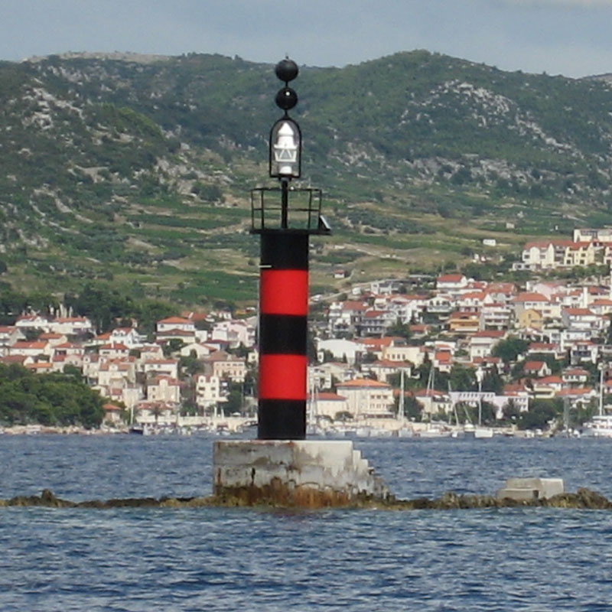
IALA Cardinal Marks
-A Cardinal Mark is used in conjunction with the compass to indicate where the mariner may find the best navigable water.
-Placed in one of four quadrants:
North (NW-NE)
East (NE-SE)
South (SE-SW)
West (SW-NW)
-May be used to:
Indicate the deepest water.
Indicate safe side to pass.
Emphasize a feature in a channel.
SEANAV I United States Naval Academy
NN220 – Fundamentals of Navigation
Operations Officer I HMS PROTECTOR A173 I The Ice Patrol Ship

Slide 24

IALA Safe Water Marks
-A Safe Water Mark is used to indicate that there is navigable water all around the mark. May be spherical, pillar or spar buoys.
-May be used as a centerline, mid channel or landfall buoy.
-Red and white vertical stripes.
-Topmark is single, red ball.
-Exhibits white light. Could be isophase, single long flash, or Morse “A”.
-May also be RACON buoy showing Morse “A”.
SEANAV I United States Naval Academy
NN220 – Fundamentals of Navigation
Operations Officer I HMS PROTECTOR A173 I The Ice Patrol Ship

Slide 25
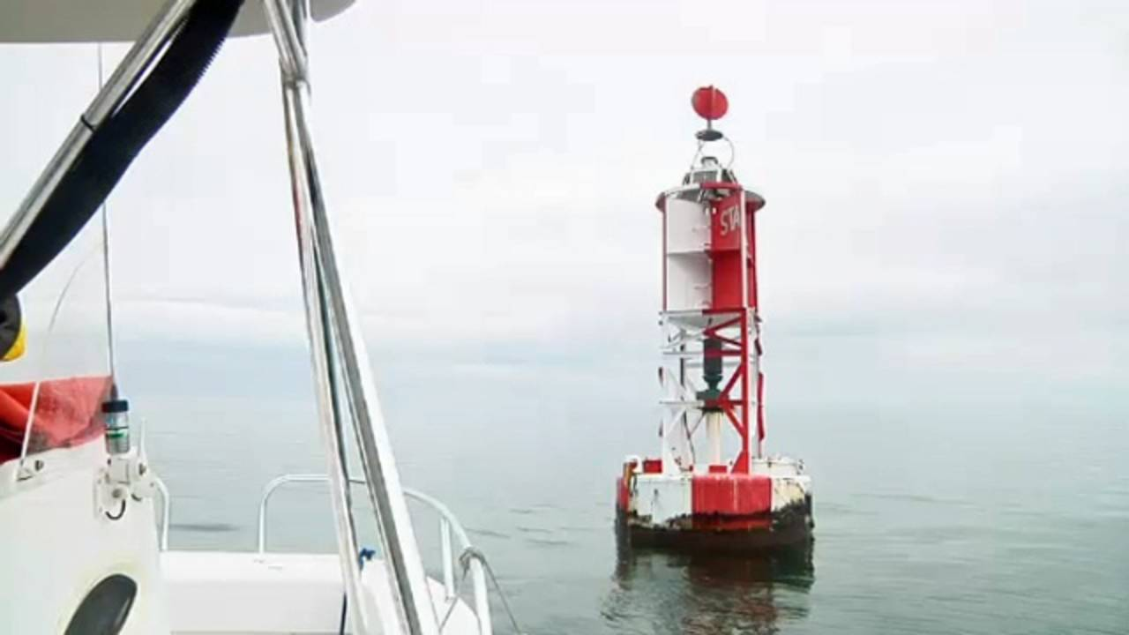
IALA Cardinal Marks
-A Cardinal Mark is used in conjunction with the compass to indicate where the mariner may find the best navigable water.
-Placed in one of four quadrants:
North (NW-NE)
East (NE-SE)
South (SE-SW)
West (SW-NW)
-May be used to:
Indicate the deepest water.
Indicate safe side to pass.
Emphasize a feature in a channel.
SEANAV I United States Naval Academy
NN220 – Fundamentals of Navigation
Operations Officer I HMS PROTECTOR A173 I The Ice Patrol Ship

Slide 26
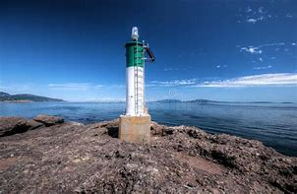
Beacons
-An Beacon is a stationary, short range visual aid to navigation that is fixed to terra firma or the seabed via a foundation. -Typically referred to as fixed aids. -They are lighted, unlighted, or audible. -Range in size, type and signal capabilities. -Beacons include lighthouses, major and minor lights, ranges, sector lights, daybeacons, sound signals, RACONs and AIS-ATON.
SEANAV I United States Naval Academy
NN220 – Fundamentals of Navigation
Operations Officer I HMS PROTECTOR A173 I The Ice Patrol Ship

Slide 27
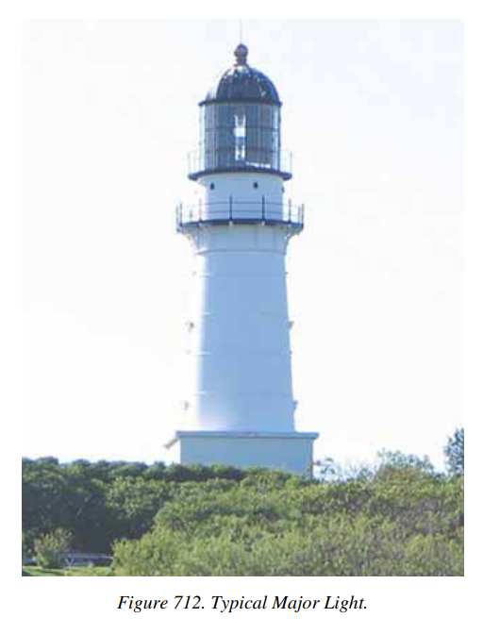
Major Lights
-A Major Light displays a high-intensity light signal with a nominal range of at least 10 nautical miles. -Used primarily as primary seacoast, coastal navigation, or harbor entrance lights. -Rarely assigned to a lateral system.
SEANAV I United States Naval Academy
NN220 – Fundamentals of Navigation
Operations Officer I HMS PROTECTOR A173 I The Ice Patrol Ship

Slide 28
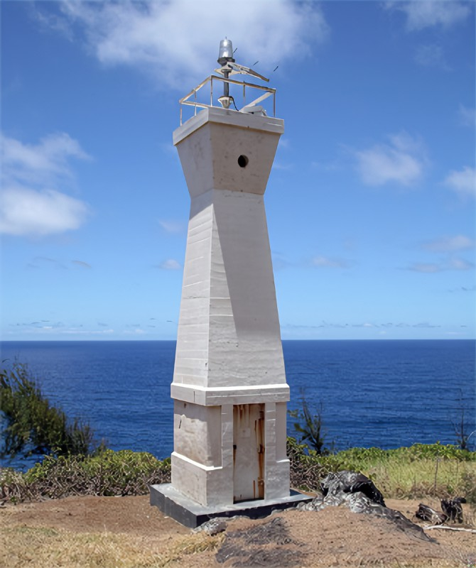
Minor Light
-A Minor Light displays lower intensity light signals with a nominal range of less than 10 nautical miles.
-Established in harbors, along channels, waterways and rivers.
-Typically assigned a numbering, coloring, and light scheme consistent with the buoyage system.
SEANAV I United States Naval Academy
NN220 – Fundamentals of Navigation
Operations Officer I HMS PROTECTOR A173 I The Ice Patrol Ship

Slide 29
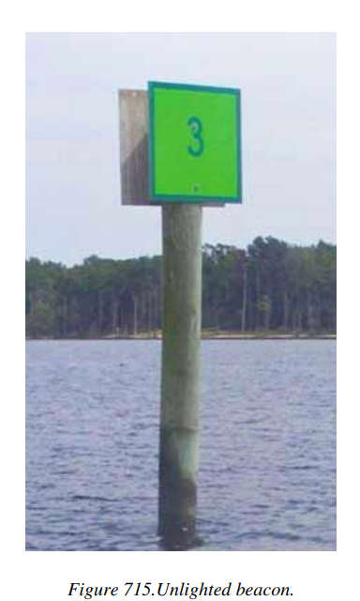
Unlighted Beacons
-An Unlighted Beacon is a beacon identified by color, shape and lateral number. -Simplest form is a dayboard attached to a wooden pylon. -Will have reflective background, edges and numbers to assist with evening navigation. -Typically assigned a color and numbering scheme consistent with the buoyage system.
SEANAV I United States Naval Academy
NN220 – Fundamentals of Navigation
Operations Officer I HMS PROTECTOR A173 I The Ice Patrol Ship

Slide 30
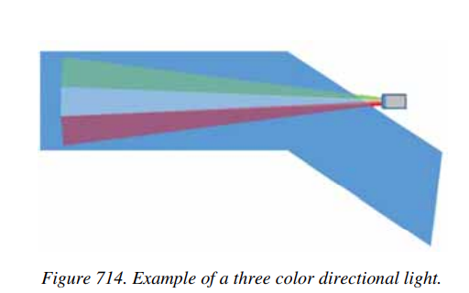
Sector Lights
-A Sector Light, or commonly called Port Entry Lights or Directional Lights, are comprised of a single light source fitted with a lens that projects three or more narrow high intensity light arcs of different colors.
-These light arcs correspond with a bearing line, typically aligned to a channel.
-This will help the navigator know if they are right, left or center of the intended track line.
-Most effective for short channels.
SEANAV I United States Naval Academy
NN220 – Fundamentals of Navigation
Operations Officer I HMS PROTECTOR A173 I The Ice Patrol Ship

Slide 31
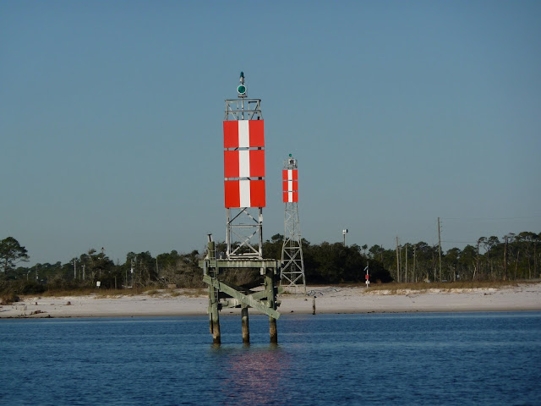
Range Lights
-A Range consists of two or more beacons so positioned with respect to each other that when seen aligned they mark a line of definite bearing, commonly the center of the channel that are built on. -Range Lights provide horizontal vessel positioning by vertically displaying white, red, green or yellow lights on top of range markers. -These are invaluable to narrow channel transits and can provide the navigator quick and efficient positional data.
SEANAV I United States Naval Academy
NN220 – Fundamentals of Navigation
Operations Officer I HMS PROTECTOR A173 I The Ice Patrol Ship

Slide 32
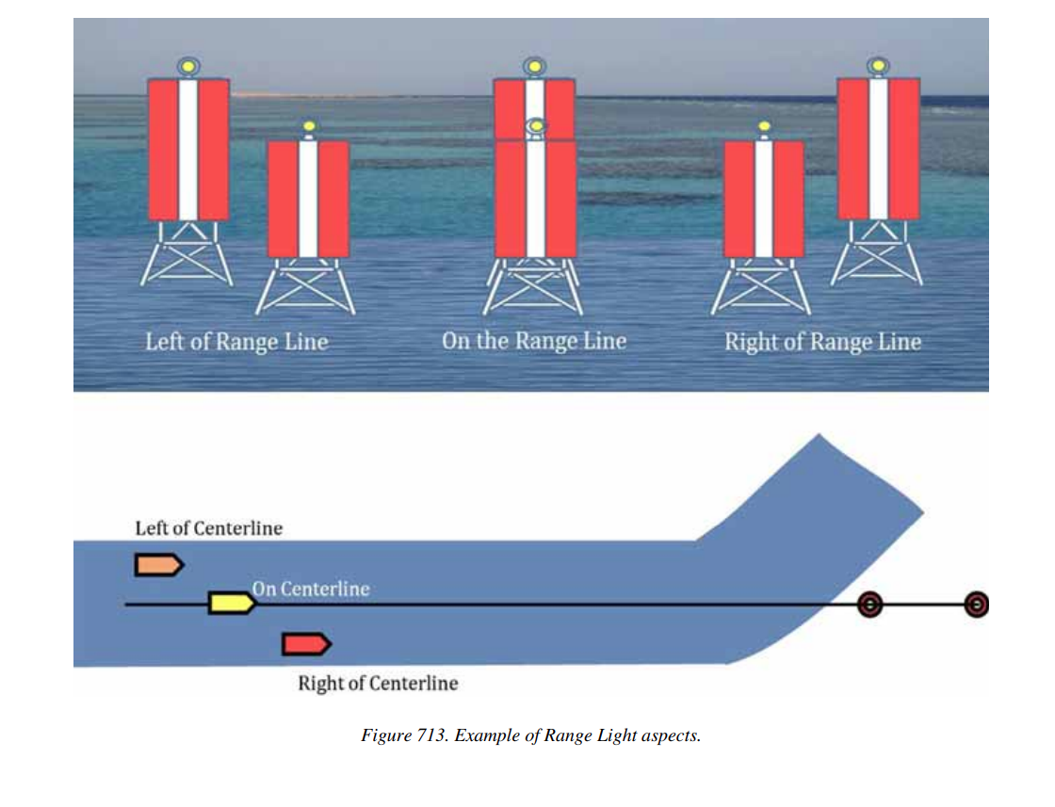
IALA Cardinal Marks
-A Cardinal Mark is used in conjunction with the compass to indicate where the mariner may find the best navigable water.
-Placed in one of four quadrants:
North (NW-NE)
East (NE-SE)
South (SE-SW)
West (SW-NW)
-May be used to:
Indicate the deepest water.
Indicate safe side to pass.
Emphasize a feature in a channel.
SEANAV I United States Naval Academy
NN220 – Fundamentals of Navigation
Operations Officer I HMS PROTECTOR A173 I The Ice Patrol Ship

Slide 33
Aids to Navigation Light Characteristics
COLOR: The four standard light colors for lighted NAVAIDs are: green, red, white and yellow.
Lights used as NAVAIDs have distinct characteristics (on/off patterns) to assist in their identification.
PERIOD: The period of a light is the time it takes for it to complete one full cycle of on-and-off changes.
They are considered fixed when they are continuously ON (rarely used because of the power consumption). A light is flashing when the time ON is less than the time OFF; and are termed occulting when they are ON more than they are OFF. If the times ON and OFF are equal, they are designated isophase.
SEANAV I United States Naval Academy
NN220 – Fundamentals of Navigation
Operations Officer I HMS PROTECTOR A173 I The Ice Patrol Ship

Slide 34
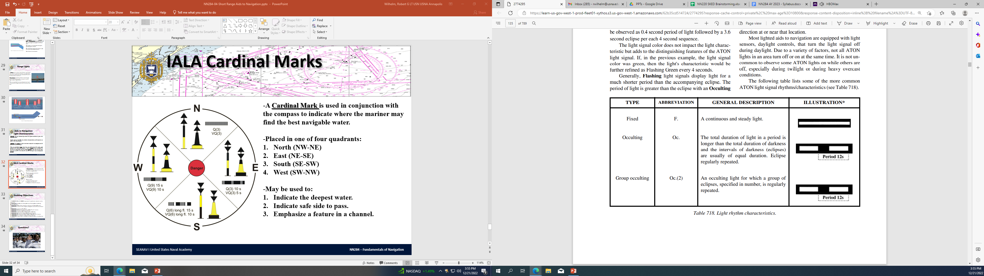
IALA Cardinal Marks
-A Cardinal Mark is used in conjunction with the compass to indicate where the mariner may find the best navigable water.
-Placed in one of four quadrants:
North (NW-NE)
East (NE-SE)
South (SE-SW)
West (SW-NW)
-May be used to:
Indicate the deepest water.
Indicate safe side to pass.
Emphasize a feature in a channel.
SEANAV I United States Naval Academy
NN220 – Fundamentals of Navigation
Operations Officer I HMS PROTECTOR A173 I The Ice Patrol Ship

Slide 35
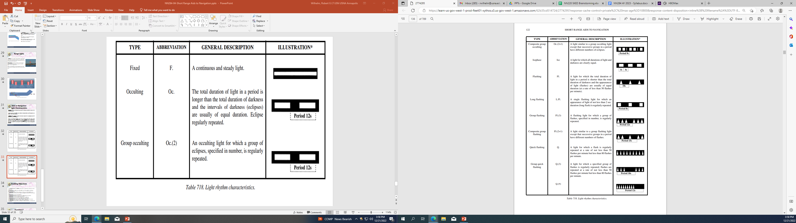
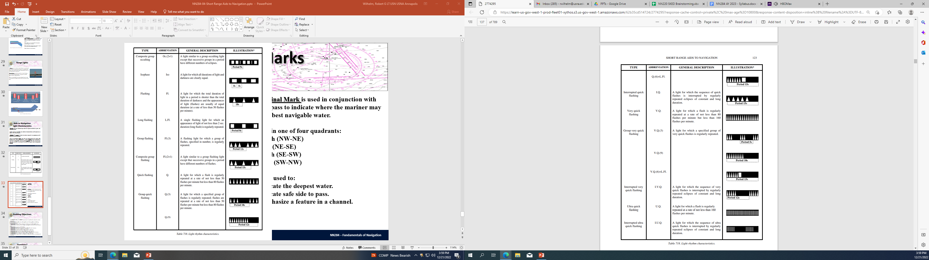
IALA Cardinal Marks
-A Cardinal Mark is used in conjunction with the compass to indicate where the mariner may find the best navigable water.
-Placed in one of four quadrants:
North (NW-NE)
East (NE-SE)
South (SE-SW)
West (SW-NW)
-May be used to:
Indicate the deepest water.
Indicate safe side to pass.
Emphasize a feature in a channel.
SEANAV I United States Naval Academy
NN220 – Fundamentals of Navigation
Operations Officer I HMS PROTECTOR A173 I The Ice Patrol Ship

Slide 36
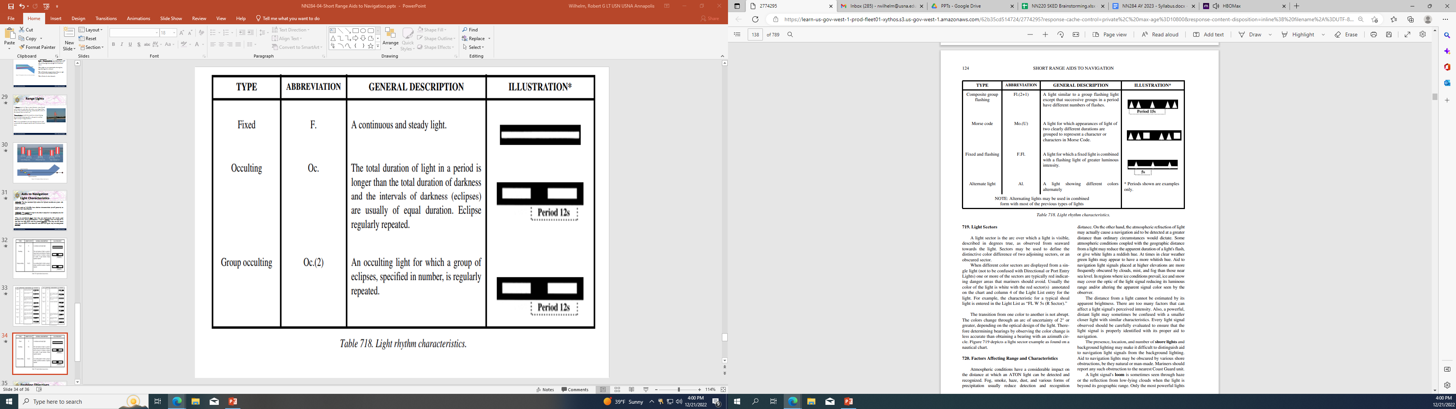
IALA Cardinal Marks
-A Cardinal Mark is used in conjunction with the compass to indicate where the mariner may find the best navigable water.
-Placed in one of four quadrants:
North (NW-NE)
East (NE-SE)
South (SE-SW)
West (SW-NW)
-May be used to:
Indicate the deepest water.
Indicate safe side to pass.
Emphasize a feature in a channel.
SEANAV I United States Naval Academy
NN220 – Fundamentals of Navigation
Operations Officer I HMS PROTECTOR A173 I The Ice Patrol Ship

Slide 37
WHAT DOES THE CHARTED DESCRIPTION MEAN?
Kago Saki Light (Fl Y 4s 75ft 15M)
Fl-what type of light characteristic
Y=Color of the Light
4s-Time it takes for light to complete one full cycle
Fixed (F)
Flashing (Fl)
Quick flashing (Qk Fl)
Very quick flashing (V Qk Fl)
Isophase (Iso)
Occulting (Occ)
Group flashing (Gp Fl)
50 < 80 flashes / minute
80 < 120 flashes / minute
< 30 flashes / minute
75 ft-Height of Eye (HOE): Required for determining light’s geographical range
15M-Nominal Range: Required for determining light’s luminous range

Slide 38
Sound Signals
-Most lighthouses, offshore light platforms, as well as minor light structures and buoys are equipped with a sound-producing device. -Sound producing devices include: Diaphones-produce sound by slotted piston moved back and forth by compressed air. Horns-produce sound by means of a disc diaphragm pneumatically and electrically. Sirens-produce sounds with either a dis or cup-shaped rotor actuated electrically or pneumatically. Not on US navigation aids. Whistles-use compressed air emitted through a circumferential slot into a cylindrical bell chamber. Bells and Gongs-sounded with a mechanically operated hammer. -Buoys can be fitted with bells, whistles or gongs actuated by wave motion.
SEANAV I United States Naval Academy
NN220 – Fundamentals of Navigation
Operations Officer I HMS PROTECTOR A173 I The Ice Patrol Ship

Slide 39
Limitations of Sound Signals
-Sound signals has several limitations: Sound travels through the air in an unpredictable manner. Under certain atmospheric conditions, some tones are inaudible. If the sound is blocked by an obstruction, the tone could be inaudible. If operate remotely, operators may not activate the sound in time. Some sound signals cannot be started immediately. Vessels engines and location of observer may also affect how they perceive the sound. -Never assume: That observer is out of hearing distance because you do not hear the sound. That because you hear it faintly, you are far away from it. That because you hear it clearly that you are close. That how you hear it one time is a guide for the next time you are near it. That the sound signal is not sounding because you don’t hear it. That the sound is emanating from the direction that you hear it coming from.
SEANAV I United States Naval Academy
NN220 – Fundamentals of Navigation
Operations Officer I HMS PROTECTOR A173 I The Ice Patrol Ship

Slide 40
U.S. Aids to Navigation System (USATONS)
-The United States has adopted the major features of the IALA system consistent with Region B. -The primary objective of USATONS is to mitigate transit risks to promote the safe, economic, and efficient movement of the military, commercial and other vessels by assisting navigators in determining their position, a safe course, and warning them of dangers and obstructions. -In accordance with Region B: Red buoys/beacons mark the starboard side of a channel when returning to port. “Red Right Returning” Buoys/Beacons increase in number coming from seaward. Red buoys/beacons are even numbered and Green buoys/beacons are odd numbered. Red buoys are Nuns and Green buoys are Cans. “Odd Green Cans” & “Even Red Nuns”
SEANAV I United States Naval Academy
NN220 – Fundamentals of Navigation
Operations Officer I HMS PROTECTOR A173 I The Ice Patrol Ship

Slide 41
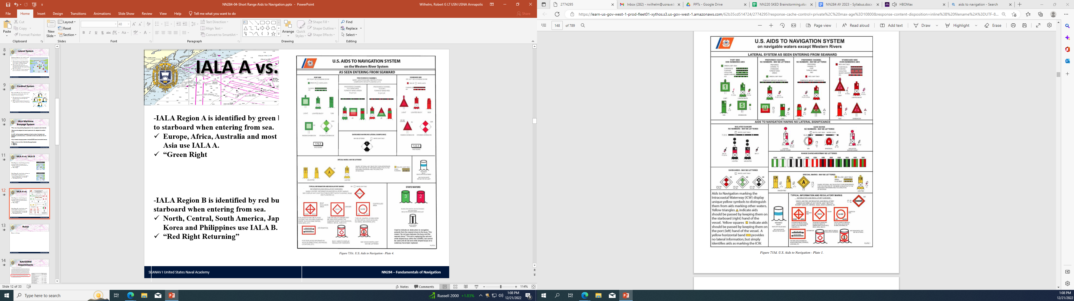
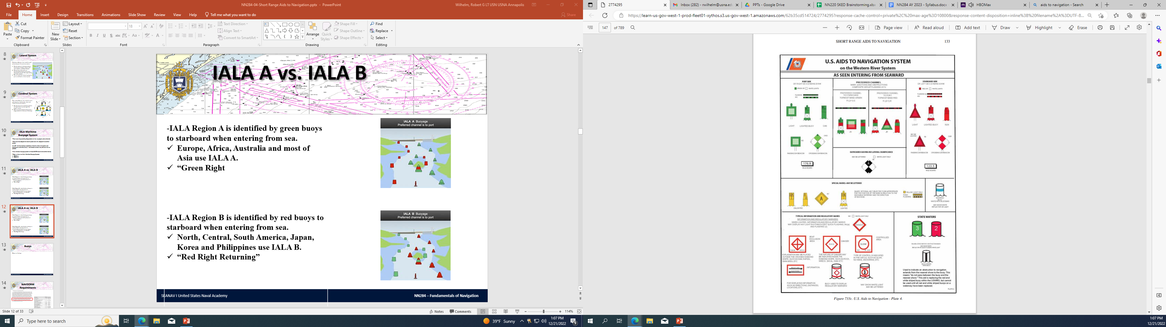
IALA A vs. IALA B
SEANAV I United States Naval Academy
NN220 – Fundamentals of Navigation
Operations Officer I HMS PROTECTOR A173 I The Ice Patrol Ship

Slide 42
Enabling Objectives
1 - UNDERSTAND the terms ATON, RACON and AIS-TON. 2 - UNDERSTAND the lateral and cardinal maritime buoyage system. 3 - DESCRIBE the International Association of Marine Aids to Navigation and Lighthouse Authorities (IALA). 4 - IDENTIFY the difference between IALA Region A and IALA Region B and know what we use in the U.S. 5 - DEFINE the term Buoy, and know the difference between Lighted, Unlighted, Special Purpose and Preferred Channel Buoys. 6 - IDENTIFY the five different buoy shapes. 7 - DESCRIBE buoy maintenance and know who is responsible for the maintenance of buoys. 8 - UNDERSTAND buoy limitations and their impact on navigation. 9 - DESCRIBE Cardinal Marks and their use. 10 - DESCRIBE Isolated Danger Marks and their use. 11 - DESCRIBE Safe Water Marks and their use. 12 - DEFINE the term Beacon, and know the difference between Major and Minor Lights, Unlighted Beacons and Sector Lights. 13 - DESCRIBE Range Lights and their application in transiting a range line. 14 - DEFINE period, fixed, flashing, occulting and isophase as they relate to light characteristics. 15 - DESCRIBE a light’s characteristics given its charted description. 16 - IDENTIFY the types of sound signals used on aids to navigation and know their limitations. 17 - UNDERSTAND U.S. Aids to Navigation System (USATONS) and its objectives with regards to navigation.
SEANAV I United States Naval Academy
NN220 – Fundamentals of Navigation
Operations Officer I HMS PROTECTOR A173 I The Ice Patrol Ship

Slide 43
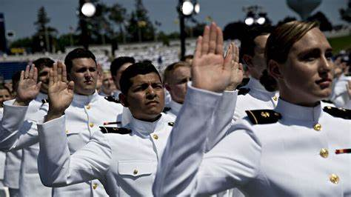
Questions?
SEANAV I United States Naval Academy
NN220 – Fundamentals of Navigation
Operations Officer I HMS PROTECTOR A173 I The Ice Patrol Ship

